Slide 1
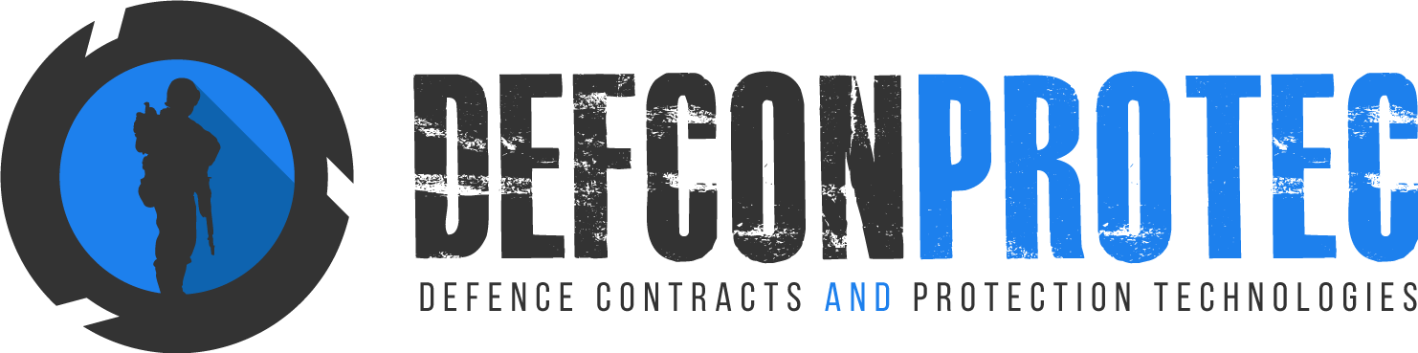
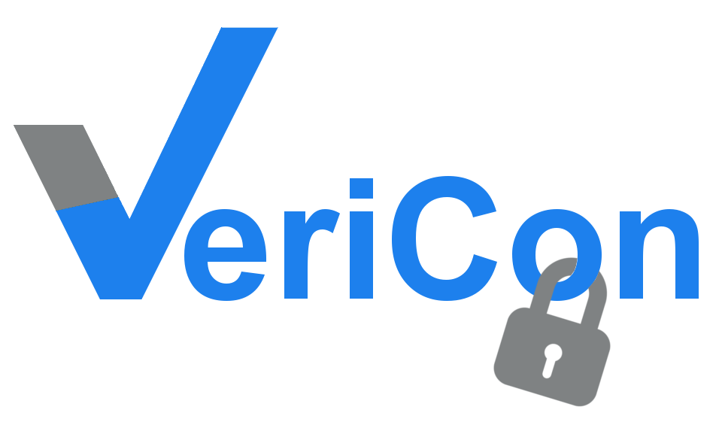
VeriCon Quality Certification Scheme

Slide 2
What is VeriCon?
VeriCon is a cloud based Quality Certification Scheme based on continuous inspections for:
  Fabrics,
  Garments,
  Footwear or
  Any other items where a performance based specification is in place.

Slide 3
Quality protection
How do you know you are getting quality products ?
VeriCon can ensure that quality is Verified and Confirmed !
Purchase or sell with confidence based on the VeriCon Quality Scheme.
Products are verified and certified against the selected test criteria. You can be sure of what you get – VeriCon gives you that assurance.

Slide 4
Swing tags
All approved products are verified by VeriCon Swing tags.
This is valid for rolls of fabric, garments, footwear or any other selected and approved items as agreed.
Every swing tag has a unique QR Code which is linked to the cloud based Certificate of Conformance or Lot Certificate.
Click, Scan and Download
Information is secure and available forever.
Green lock = Contains imported content.
Gold lock = Local Content Compliant

Slide 5
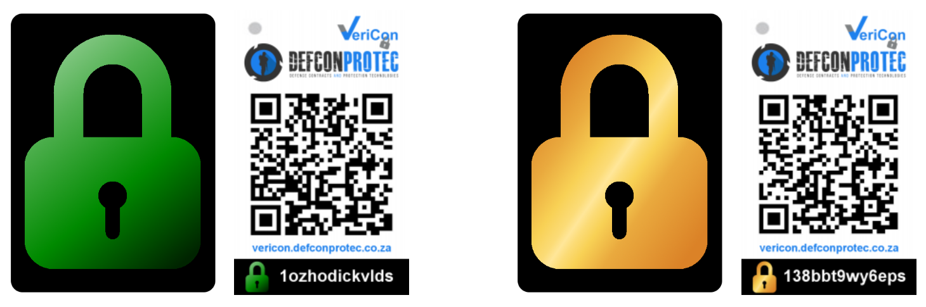
The VeriCon LOCKS signify:
• Confidence
• Continuity
• Conformance
• Risk Mitigation
• Customer Satisfaction
• Ongoing Compliance with selected criteria

Slide 6
Value proposition
A value proposition is a promise of value to be delivered, communicated, and acknowledged.
It is also an expectation from the customer that the benefit that will be delivered, experienced or acquired, will add value to their business.
VeriCon Value Proposition :
VeriCon will mitigate your quality risks, reduce your total quality costs, provide full time cloud based traceability, enabling any of your customers full time access to performance data.
Lock in performance with VeriCon

Slide 7
Buy with Confidence. Sell with Confidence
Can you verify that you hardly ever receive problem goods and that you never have to do quality checks on behalf of your suppliers?
Can you confirm you never have fabric or garment problems related to measurements, performance, colour or continuity?
Can you buy with confidence and be assured your performance risks have been mitigated?
Are you sure specific performance criteria have been checked and complied with?
Can you readily access the test data or Certificates of Conformance in a matter of minutes?
Do you have ongoing records of performance for your product that anyone can access even years after the goods have been supplied?
Do have visible identification on your products that show your customers they can purchase with confidence – quality related labels or swing tags?
The VeriCon Labelling Scheme address all these concerns.

Slide 8
The Vericon process – step by step
Phase 1 – product approval
Supplier is audited in terms of a BCR (Business Capability Report)
  The key purpose is to determine whether the business has the capability to supply quality products on a continuous basis.
The item or items to be VeriCon approved is selected
  There must be a SANS Specification, Private Specification, or a Customer Specified Specification that the selected product needs to comply with.
  The specification needs to be relevant to the proposed end use requirements.
Product samples are drawn and tested against the selected specification.
Product compliance with selected specification requirements will gain approval for the VeriCon quality certification scheme.

Slide 9
The Vericon process – step by step
Phase 2 – product listing
Approved Products from Approved Suppliers are listed on the VeriCon webpage.
  All listings are valid for a period of 1 year.
The VeriCon webpage is accessible to all Purchasing Authorities looking for suitable approved suppliers.
Defcon Protec continuously market and promote the VeriCon scheme to Purchasing Authorities and will reference the Approved Suppliers lists with prospective buyers.

Slide 10
The Vericon process – step by step
Phase 3 – production approvals
The Supplier notifies Defcon Protec regarding any new Production runs on the Approved Product.
  Defcon Protec receives samples at the start of the Production run. (Supplied or Collected)
  Pre-Production samples are checked for performance against the Approved Specification.
  If samples comply with requirements, a COC (Certificate of Conformance) is issued by the SANAS approved Laboratory.
  The COC is uploaded to the Defcon Protec Cloud based data storage facility.
  Documents and records for the Production run is supplied to Defcon Protec – similar to requirements for a Consignment Lot Inspection.
Customer receives notification regarding sample approvals.
Swing Tags with QR Code linked to COC is issued to Supplier.
  The number of swing tags will match the number of units in the inspection Lot.
  Customer can add Swing Tags to units during Production or Inspection.

Slide 11
Ongoing verification
Defcon Protec will do ongoing audits and checks on Approved Suppliers to ensure compliance with specifications.
Any Quality Complaints or Product deviations will be followed up and Defcon Protec will ensure that Corrective Actions are put in place to ensure continuous conformity to specifications.
Should products fail subsequent tests or inspections, VeriCon approvals may be placed on hold or withdrawn depending on severity of breach.
Defcon Protec will back up data to ensure safekeeping of all COC Records. Data will be preserved for 10 years and will then be archived.

Slide 12
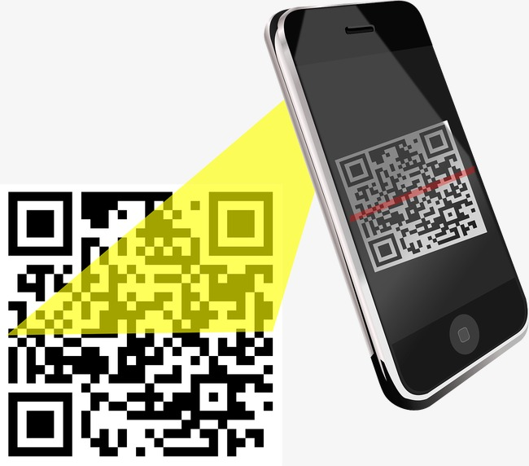
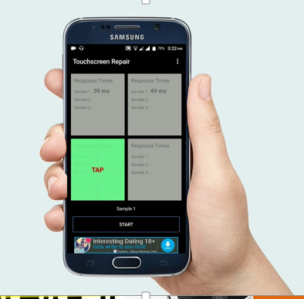
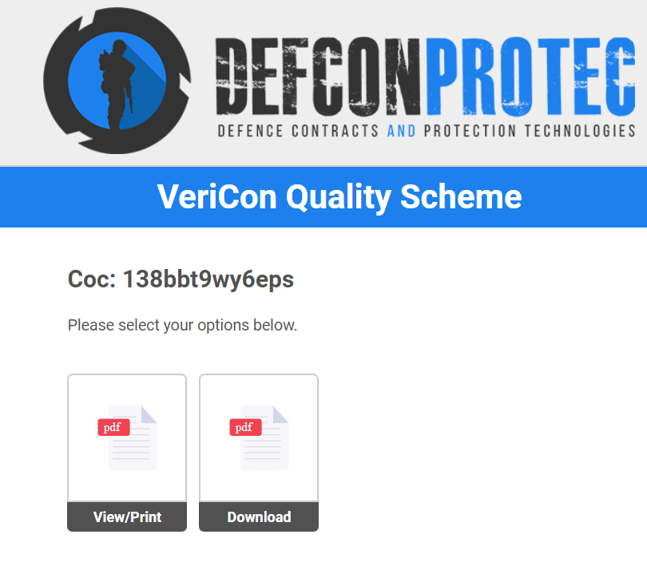
Click, Scan and Download
To access the COC or Lot Certificates, simply scan the QR Code on the Swing Tag.
+
=

Slide 13
View the certificate of conformance
Once QR Code is scanned, select to view, print or download the test report

Slide 14
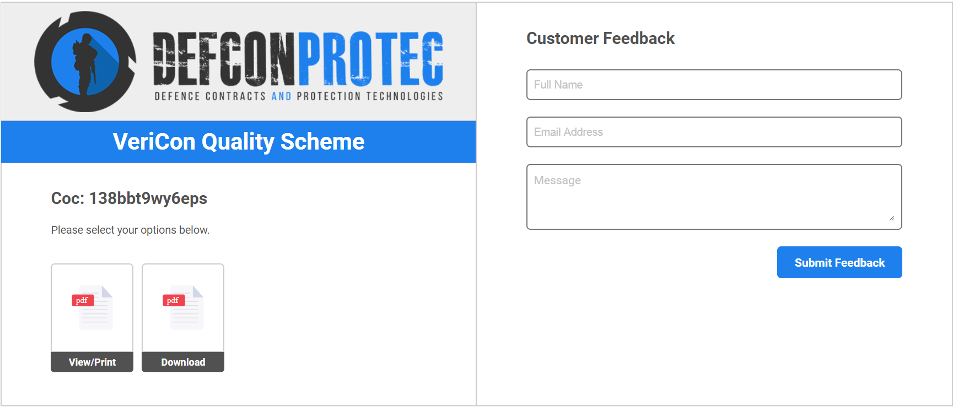
Feedback from cell phone

Slide 15
COSTS
1. Standard cost for BCR = R6,600 + Travel Costs
2. Standard cost for Local Content Verification if required = R4500 + Travel Costs.
3. VeriCon Label Scheme = Sample evaluation costs as per price list.
  SANAS ATS Lab fabric/footwear testing.
  SANAS Defcon Protec sample evaluation charges for garments/selected items.
  SANAS Partner Laboratory costs for external testing.
4. VeriCon consignment inspection costs at percentage of consignment value as per table below.
  Includes sample testing and evaluation.
  Includes VeriCon labels.
  Includes COC issue, QR Code generation and Cloud Based data storage.
Consignment Value | % Cost
Up to R200,000 | 5,0
R200,001 to R400,000 | 4,5
R400,001 to R600,000 | 4,0
R600,001 to R800,00 | 3,5
R800,001 to R1,000,000 | 3,0
R1,000,000 and over | 2,5

Slide 16
VERICON
Lock in performance
Lock out your competitors

